Slide 1
How to win an argument
JONATHAN HABER

Slide 2
Jonathan Haber
Curriculum Developer and Author – Critical Voter
Curriculum Developer, Woodrow Wilson Academy at MIT
Chief Learner – Degree of Freedom One Year BA Project
Author of MOOCS: The Essential Guide (MIT Press)
Inaugural HarvardX Visiting Fellow
Founder and CEO of SkillCheck, Inc. and creator of the Internet and Computing Core Certification (IC³)
Co-author of National Educational Technology Standards (NETS*S): Resources for Assessment published by the International Society for Technology in Education (ISTE)

Slide 3
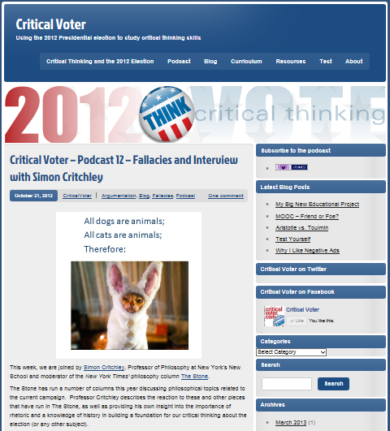
CRITICAL VOTER (www.criticalvoter.com)

Slide 4
Practical critical thinking
Logic
Argumentation
Rhetoric
Media and Information Literacy
Cognitive Science

Slide 5
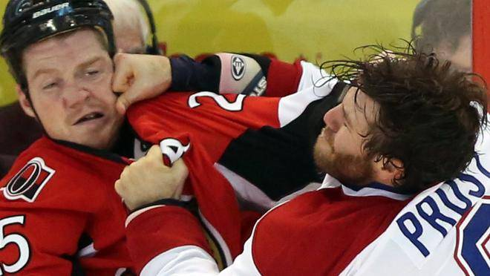
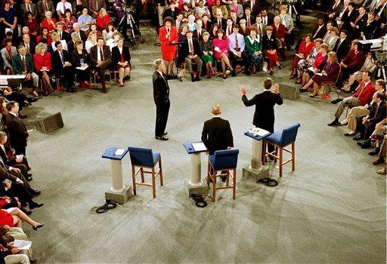
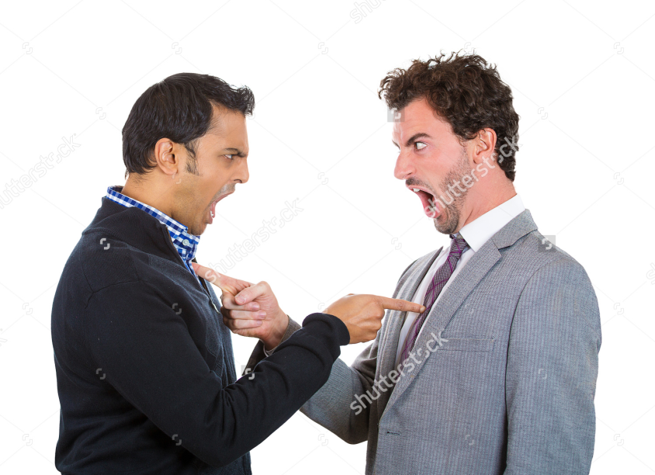
What is an argument?

Slide 6
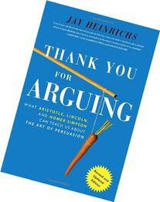
What is an argument?
“You fight to win,” he writes; “you argue to achieve agreement.”
Jay Heinrichs
Author, Thank You for Arguing

Slide 7
Modes of persuasion
Logos - Logic
Pathos - Emotion
Ethos - Connection

Slide 8
audience

Slide 9
Types of arguments
Forensic Arguments
Demonstrative Arguments
Deliberative Arguments

Slide 10
Powerful arguments
Based on sound understanding (know what you’re talking about)
Logically coherent (premises lead to the conclusion)
Identity and needs of the audience taken into account
Correct balance of logic, emotion and connection to the audience (ethos)
Carried on in the proper tense (past, present or future)
Principled goals and a desire to achieve agreement or understanding

Slide 11
Rhetorical devices
https://www.youtube.com/watch?v=LHjbQ3CUsZ8

Slide 12
Rhetorical devices
Linguistic devices
Literary (metaphor, alliteration, assonance, consonance, rhyming)
Oral (anaphora, tricolon, chiasmus)
Strategic devices
Procatolepsis
Rhetorical Questions
Innuendo
Story-formation

Slide 13
bias
https://www.youtube.com/watch?v=vJG698U2Mvo

Slide 14
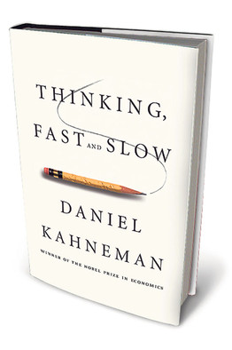
Cognitive biases
Examples of biases:
Anchoring
Framing
Bandwagon Effect
Halo Effect
Confirmation Bias

Slide 15
Q&A

